Slide 1

“MACHINE LEARNING BASED USER SERVICE RECOMMENDATION”
SAHIL RAJ 1SI20AD022
PAMULAPATI JYOTHIKA CHOWDARY 1SI20AD014
SACHITHA D 1SI20AD021
SHUBHAM KUMAR GUPTA 1SI20AD026
Under the guidance of
Dr.Srinivasa K(ph.d.)
Assistant professor
Siddaganga institute of technology, Tumukur-3
(Program Accredited by NBA)
Department of Computer Science and Engineering
Branch: Artificial Intelligence and Data Science
Academic Year: 2022-23

Slide 2
INTRODUCTION
Machine learning based user service recommendation is a website that recommends services to users right at their door based on their needs and requirement.
The user's existence is made easier by this. The customer will be able to access all the services through this website at their convenience both in terms of location and timing. It is built using machine learning, a branch of artificial intelligence used to create highly effective and efficient recommendations.
They can get the help they need from plumbers, electricians, carpenters, salons, women's therapists, cleaners, men's therapists, etc.
Overall, machine learning-based user service recommendation is a powerful tool for businesses looking to improve their customer experience and increase revenue.
By leveraging advanced algorithms and data analysis, it can provide highly personalized and effective recommendations to users, improving their satisfaction and loyalty to the brand.

Slide 3
MOTIVATION
•Problems in household task, whether it is cleaning, repair, cooking, or any other work in our daily lives
•Difficulties with the low wages group of workers have a difficult time finding work. Even if they find work, they are afraid of losing it, and they are not always treated well

Slide 4
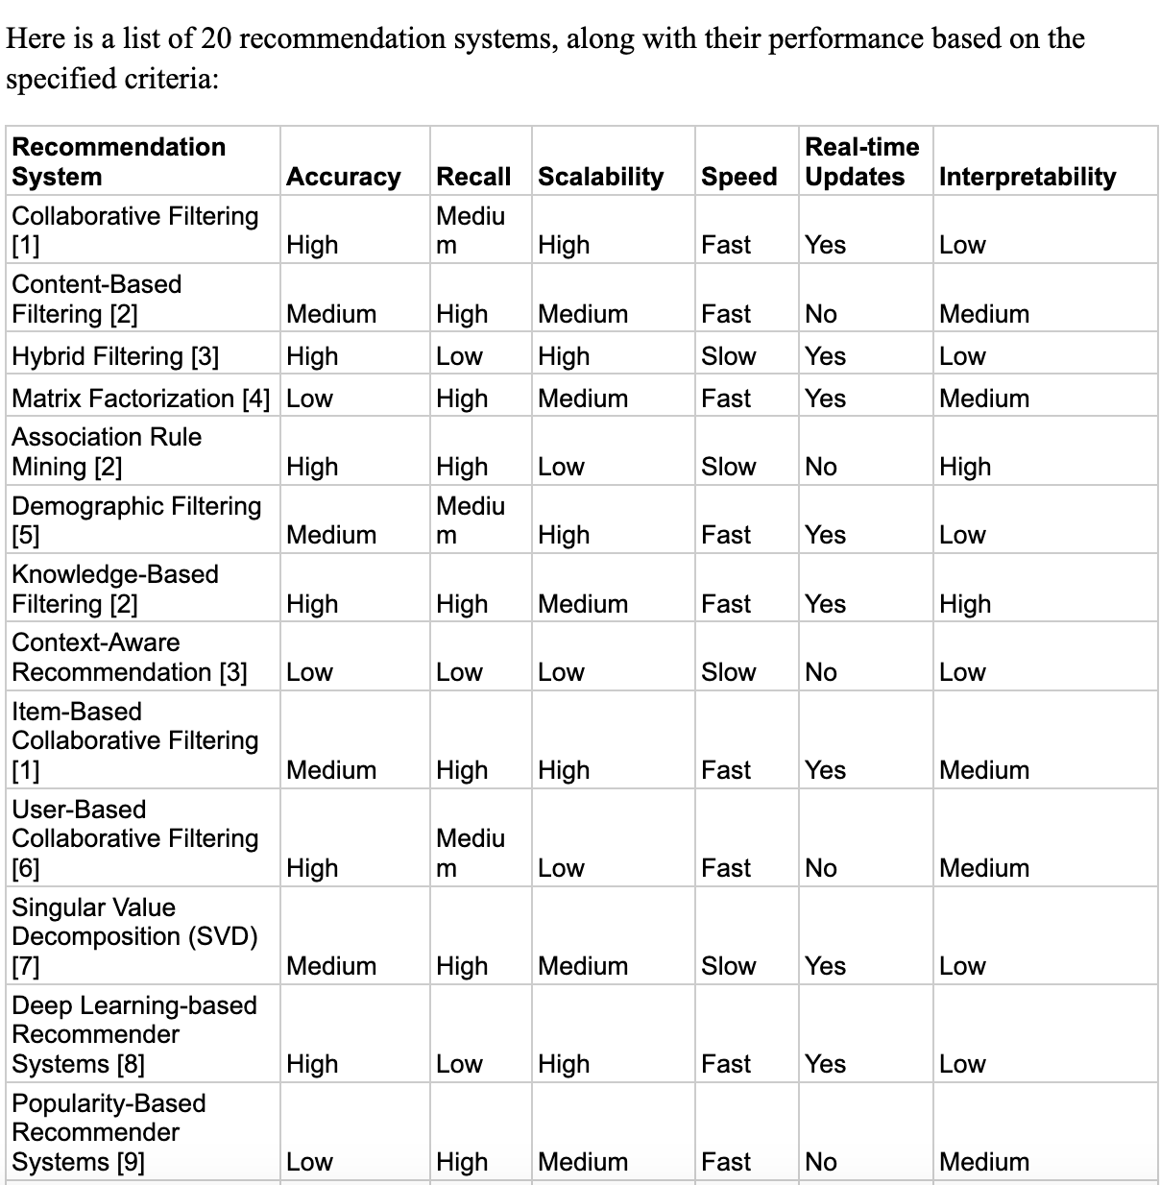



LITERATURE SURVEY
:

Slide 5
PROBLEM STATEMENT & OBJECTIVES
PROBLEM STATEMENT
OBJECTIVES
To create a platform for household needs which helps providing jobs to a greater number of employees
The goal is to provide jobs to workers near their native so that they need not to travel far from their family to sustain their lives.
Create a website with which can handle this task while implementing a recommendation system for providing better results.
Web Design: We are going to build a website with a great UI design using JAVASCRIPT, CSS and HTML.
Authentication: For providing great security we are using JWT
Databases: For storing the data of each user we need to use real-time database MONGODB for implementing so.
Recommendation: We will be creating a recommendation system based on Machine learning

Slide 6
Abstract
The project focuses on the development of a web-based platform that addresses the employment needs of skilled workers by providing job opportunities in close proximity to their residences. Leveraging modern web technologies, the platform aims to connect service providers and job seekers in a seamless manner. To enhance user experience and security, the platform will utilize JWT authentication. Real-time data management will be facilitated by integrating a MongoDB database. A key feature of this platform is the implementation of a recommendation system that employs machine learning techniques to suggest suitable job opportunities to workers based on their skills and preferences. By offering convenience, employment opportunities, and enhanced quality of life, the platform aims to revolutionize the way household services are accessed and delivered.

Slide 7
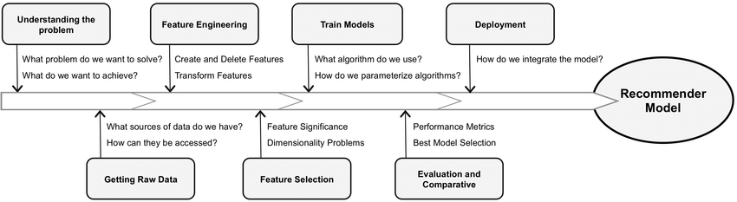
METHODOLOGY

Slide 8
TOOL AND TECHNOLOGIES
JAVASCRIPT: JavaScript is a scripting language that enables you to create dynamically updating control multimedia, animate images, and pretty much everything else.
HTML: HTML is the markup language that we use to structure and give meaning to our web content
DJANGO: For backend development we have used Django. Django is a high-level Python web framework that enables rapid development of secure and maintainable websites.
JWT: JSON Web Token is an open industry standard used to share information between two entities, usually a client
MONGODB: MongoDB is a document database used to build highly available and scalable internet applications
CSS: CSS is a language of style rules that we use to apply styling to our HTML content
Razorpay Payment Gateway: For payments, we will use Razorpay payment integration using API.
MACHINE LEARNING: implementing recommendation customers
GOOGLE MAPS: For location services we will use Google Maps API.

Slide 9

EXPECTED OUTCOME
The platform will provide a convenient and efficient way for job seekers to access employment opportunities without compromising their family life.
By suggesting tailored job options to users based on their skills and preferences, the platform will enhance the overall job-seeking experience.
Workers and employers alike will benefit from reduced travel time and costs, leading to increased job satisfaction and productivity.
The recommendation system's implementation will lead to improved job matches, increasing the likelihood of long-term employment relationships.
The success of the platform will contribute to the growth of the local economy by fostering job creation and supporting small-scale service providers.

Slide 10
CONCLUSION
When we need to complete a household task, whether it is cleaning, repair, cooking, or any other work in our daily lives, we face a huge problem in finding a worker to complete the task. So, we decided to solve this problem using cutting-edge technologies and our software expertise.
Even workers from the lower and middle classes have a difficult time finding work. Even if they find work, they are afraid of losing it, and they are not always treated well. Such issues will not exist if there are plenty of jobs available, and many families will not suffer.
With this motivation in mind, we are launching a real-life project that will have a positive impact on society.

Slide 11
THANK YOU

